Slide 1

FORECASTING GOLD PRICES
TEAM MEMBERS (GROUP 6):
AMAAD AHMED GAGROO
AMAN KUMAR
AKASH KUNDU
ARNICA SAIKIA
DHANALAKSHMI S
KAUSHALENDRA SINGH
SHUBHAM
MENTOR : KARTHIK
DATE : 14.04.2022

Slide 2
BUSINESS OBJECTIVE :
DATA PROVIDED IS RELATED TO GOLD PRICES. THE OBJECTIVE IS TO UNDERSTAND THE UNDERLYING STRUCTURE IN YOUR DATASET AND COME UP WITH A SUITABLE FORECASTING MODEL WHICH CAN EFFECTIVELY FORECAST GOLD PRICES FOR NEXT 30 DAYS.
THIS FORECAST MODEL WILL BE USED BY GOLD EXPORTING AND GOLD IMPORTING COMPANIES TO UNDERSTAND THE METAL PRICE MOVEMENTS AND ACCORDINGLY SET THEIR REVENUE EXPECTATIONS

Slide 3

PROJECT ARCHITECTURE
Step-1 :
Data set collection
Step-2 :
Data cleaning
Step-3 :
EDA phase
Step-4 :
Model Building
Step-5 :
Finalize best model.
Step-6 :
Compare actual and predicted values.
Step-7 :
DeployMENT
USING sTREAMLIT

Slide 4
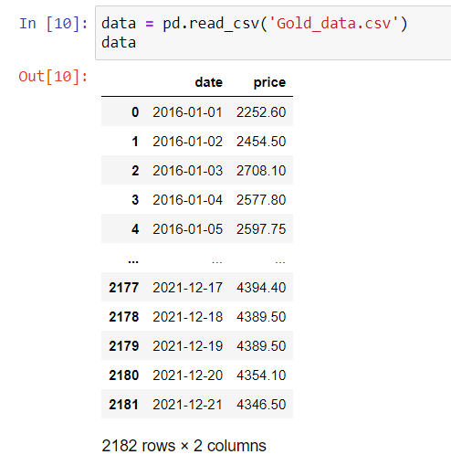
DATA SET COLLECTION & CLEANING
2182 rows & 2 column
Year range 01-01-2016 to 21-12-2021
These are the explanations for variables.
1) Date (object) : Daily entry date
2) Price (Float64) : Gold Price

Slide 5
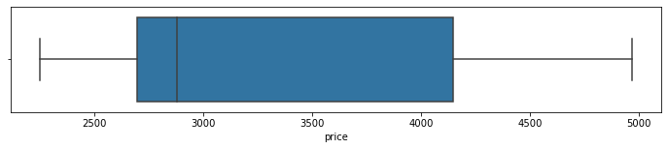
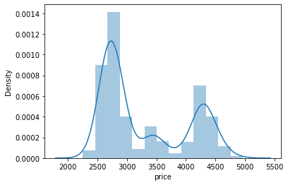
BOXPLOT FOR PRICE & NO OUTLIERS
DISTPLOT OF PRICE DENSITY

Slide 6
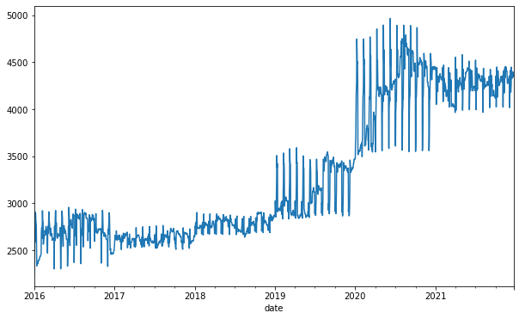
TREND IS UPWARD OR POSITIVE

Slide 7
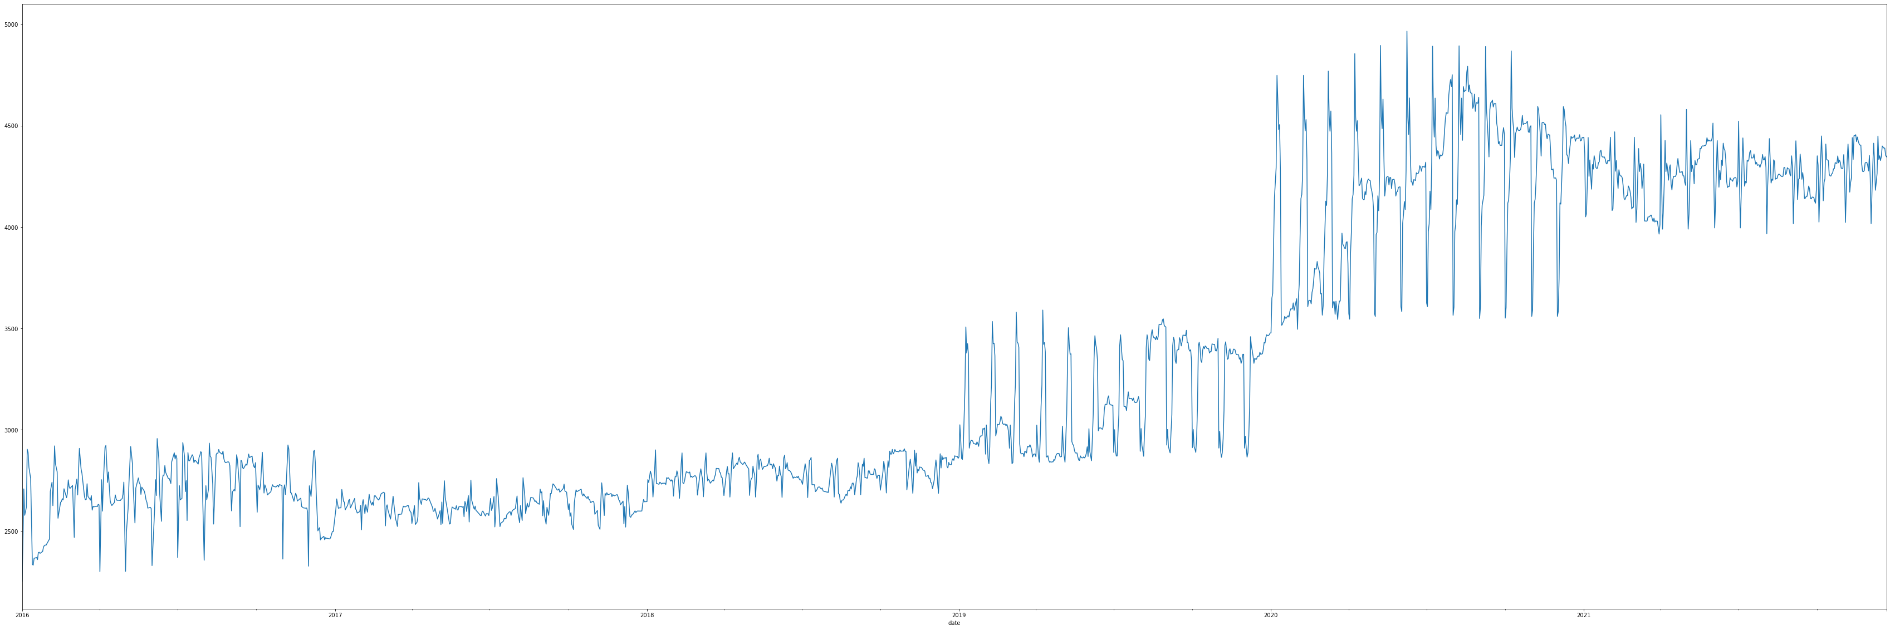
SEASONALITY CAN BE OBSERVED A LITTLE BIT

Slide 8
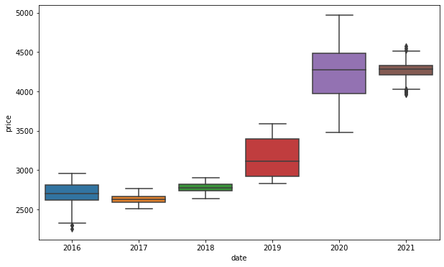
THE GROWTH IN PRICE HAS MUCH MORE OF
AN EXPONENTIAL GROWTH

Slide 9
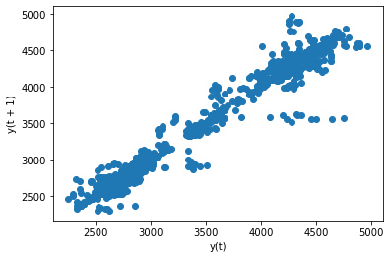
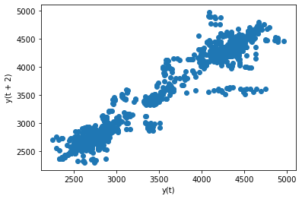
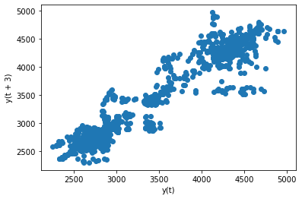
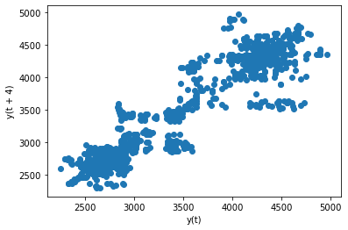
OBSERVE CORRELATIONS BETWEEN VARIABLES : lagplot with lag 1 ,2,3 and 4 suggests the positive correlation
lag_plot :1
lag_plot :2
lag_plot :3
lag_plot :4

Slide 10
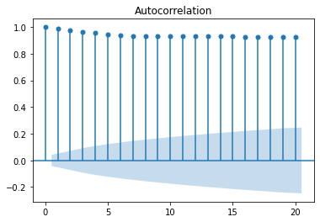
THE AUTOCORRELATION PLOT SUGGESTS THE IMMEDIATE LAGS HAVE ENOUGH SIGNIFICANT RELATIONSHIP TO BUILD A GOOD FORECASTING MODEL ON

Slide 11
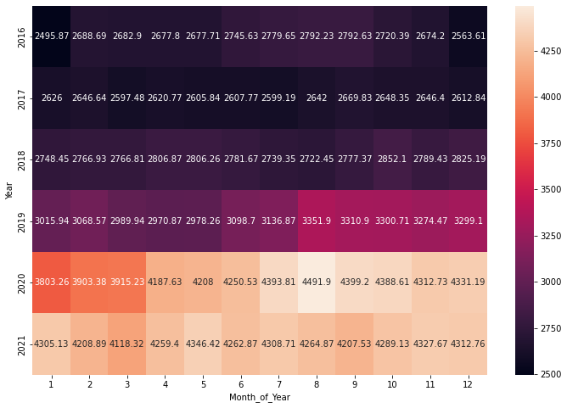
HEAT MAP VISUALIZATION OF THE DATA ON MONTHLY OF EACH YEAR

Slide 12
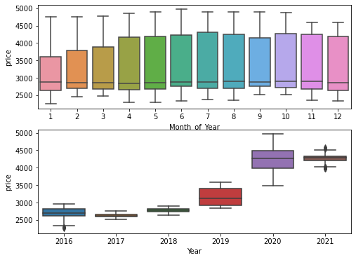
BOXPLOT FOR EVERY MONTH THROUGHTOUT ALL THE YEARS

Slide 13
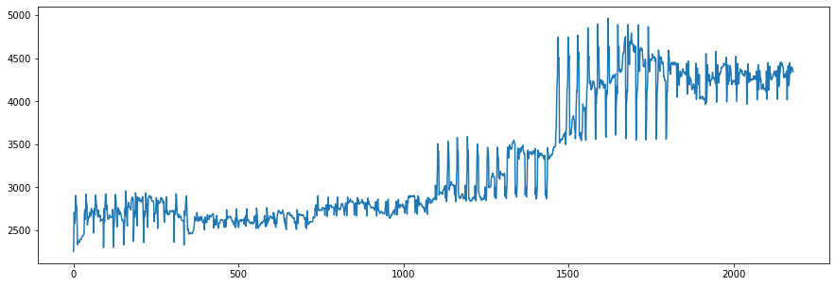
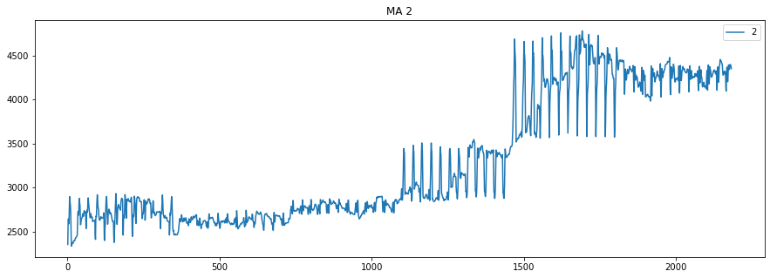
MOVING AVERAGE TO FIND OUT ANY VISIBLE TREND

Slide 14
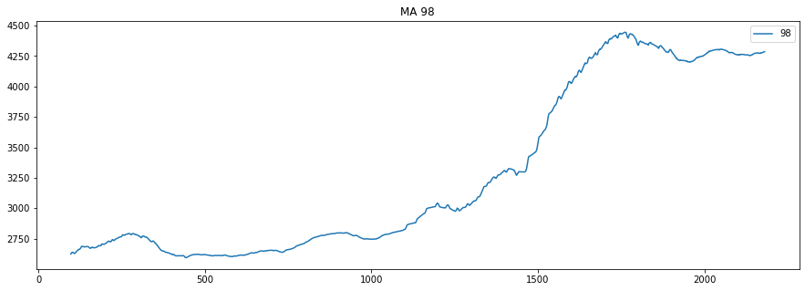

MOVING AVERAGE TO FIND OUT ANY VISIBLE TREND
UPTO MA 99 PLT.SHOW

Slide 15
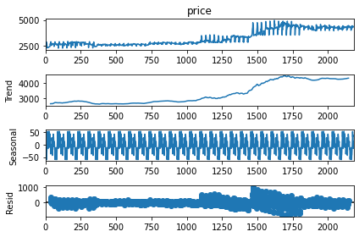
TIME SERIES DECOMPOSITION PLOT

Slide 16
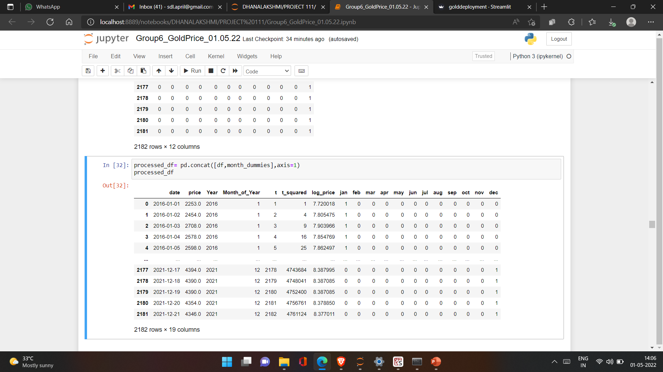
PREPROCESS DATA

Slide 17
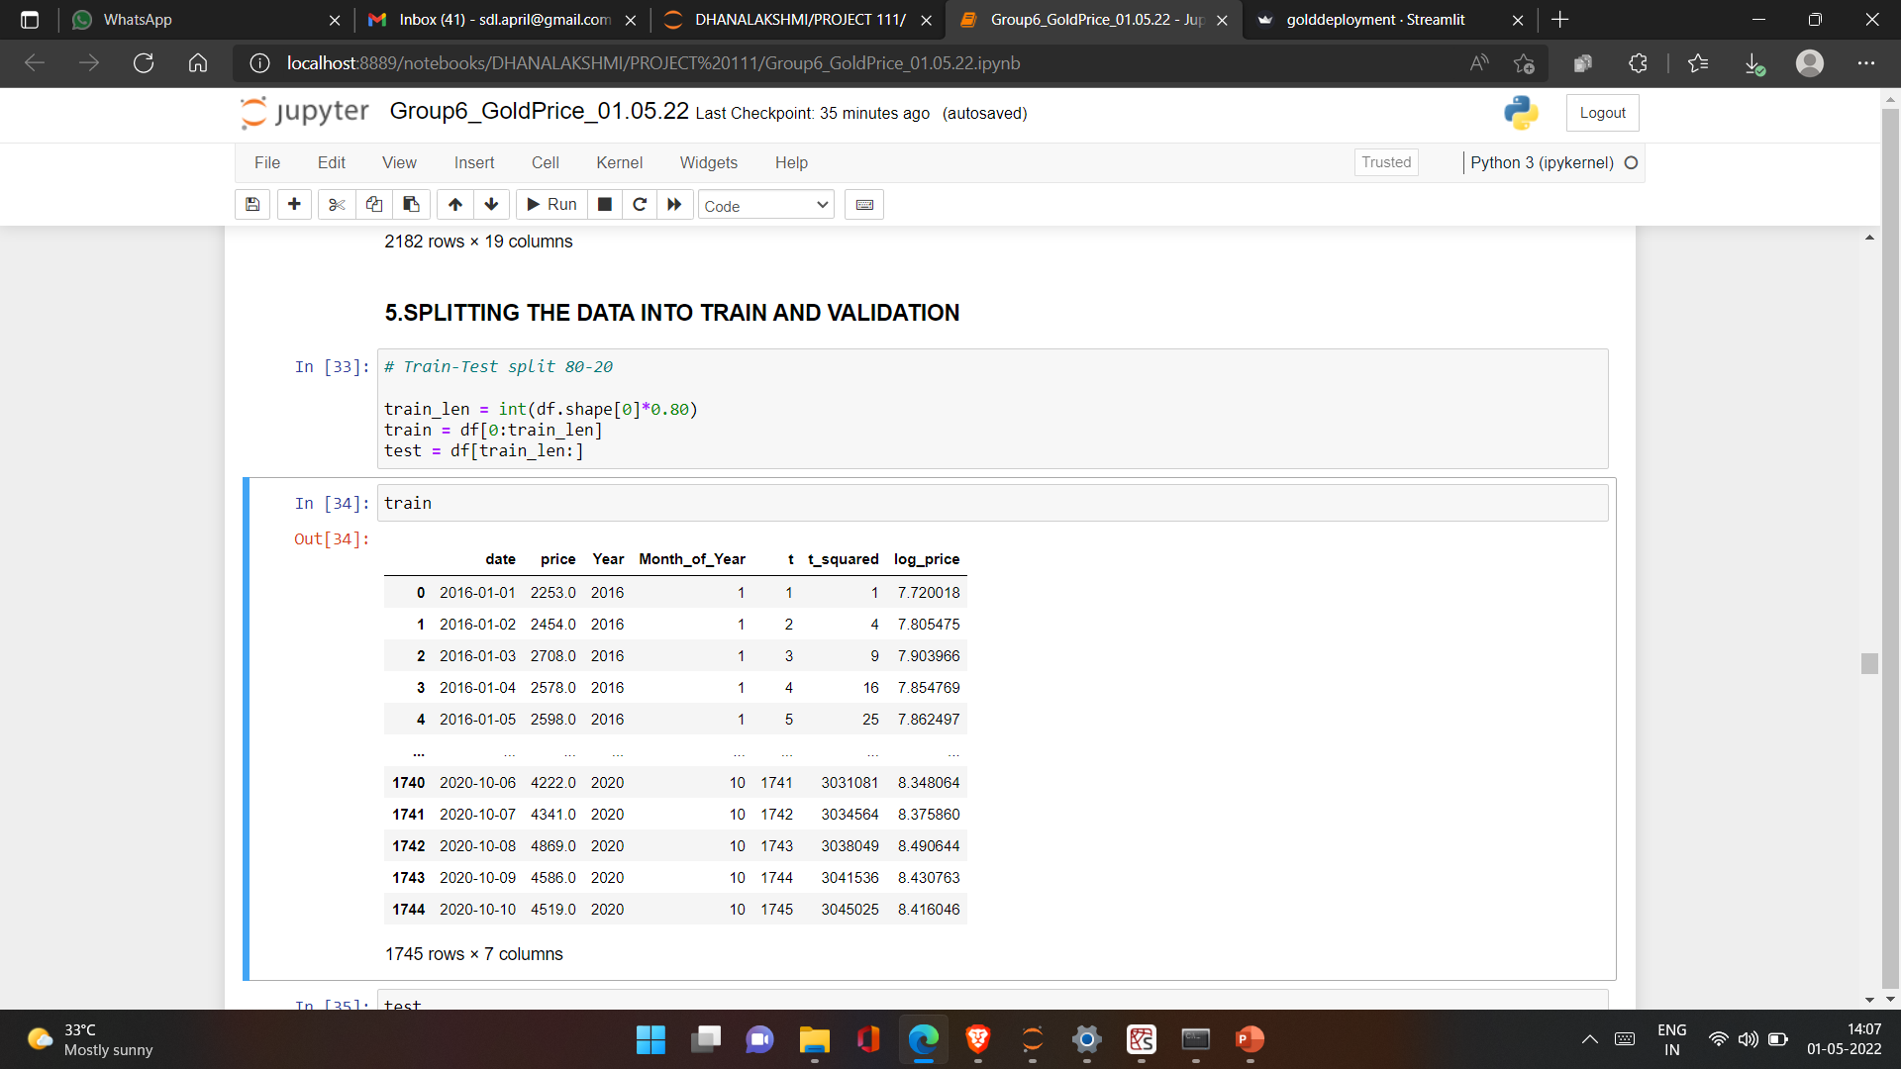
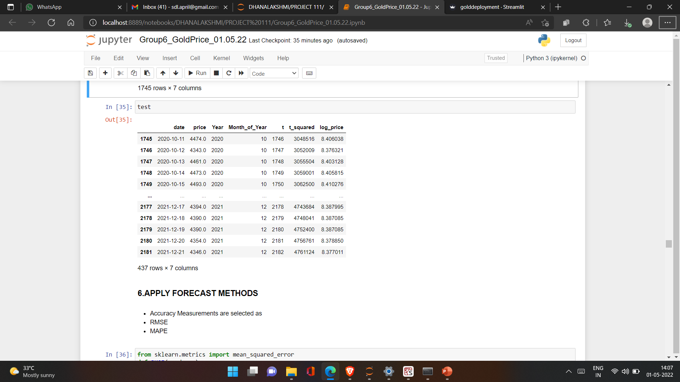
SPLITTING THE DATA INTO TRAIN AND VALIDATION

Slide 18
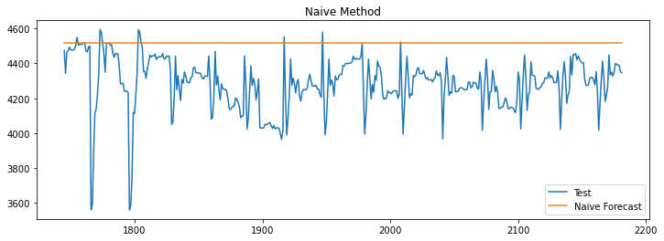
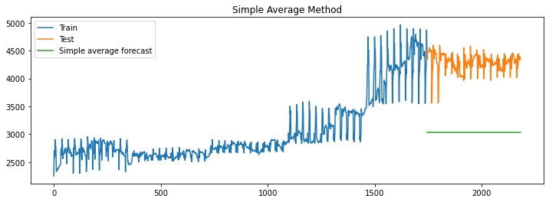
APPLY FORECAST METHODS
Expected forecast is the last actual value
Predicted value is the arithmetic average of all previous points

Slide 19
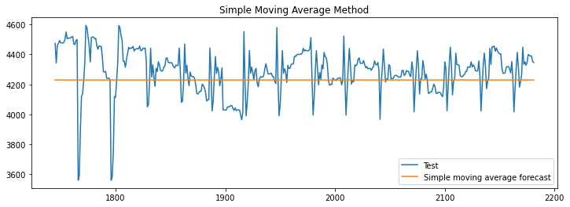
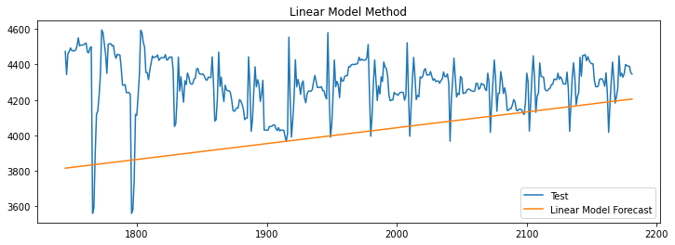
APPLY FORECAST METHODS…..CONDT….
Predicted value is average of previous window values
Trying to fit a straight line

Slide 20
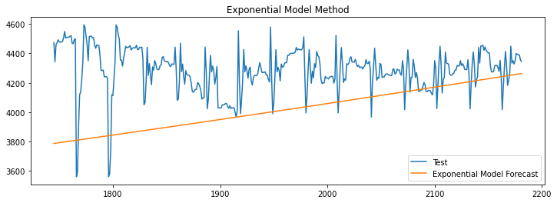
APPLY FORECAST METHODS…..CONDT….
Fitting an exponential line

Slide 21
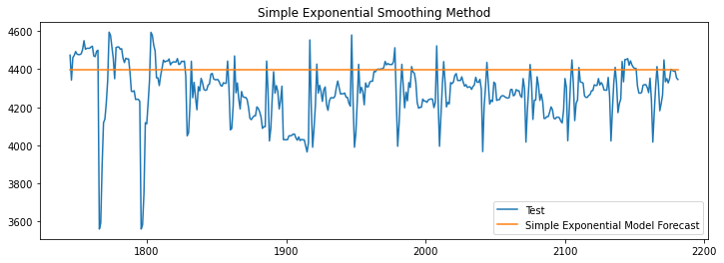
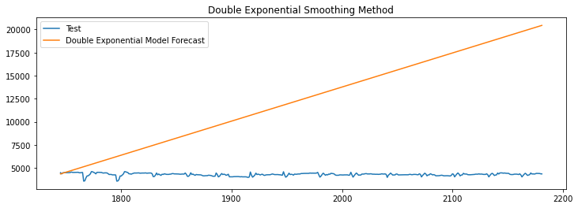
SMOOTHING METHODS

Slide 22
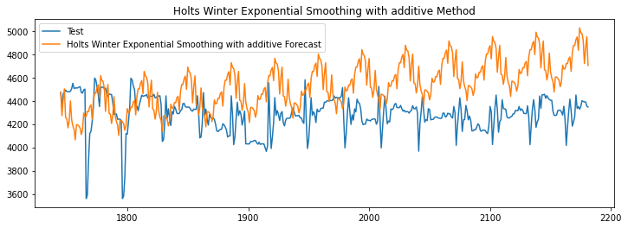
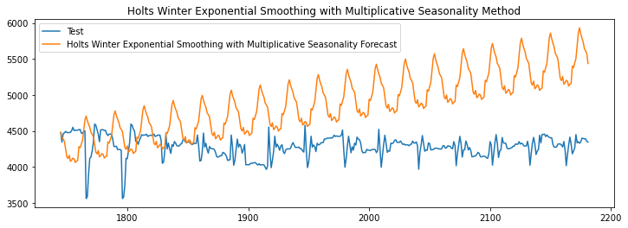
SMOOTHING METHODS….CONDT..

Slide 23
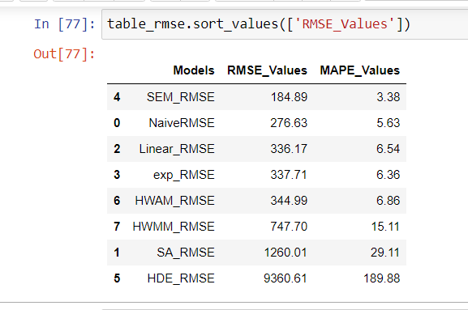
COMPARING ALL MODELS ACCURACY

Slide 24
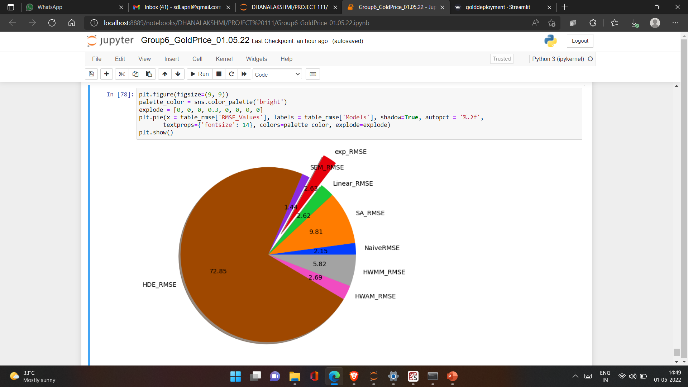
TABLE_RMSE_VALUES

Slide 25
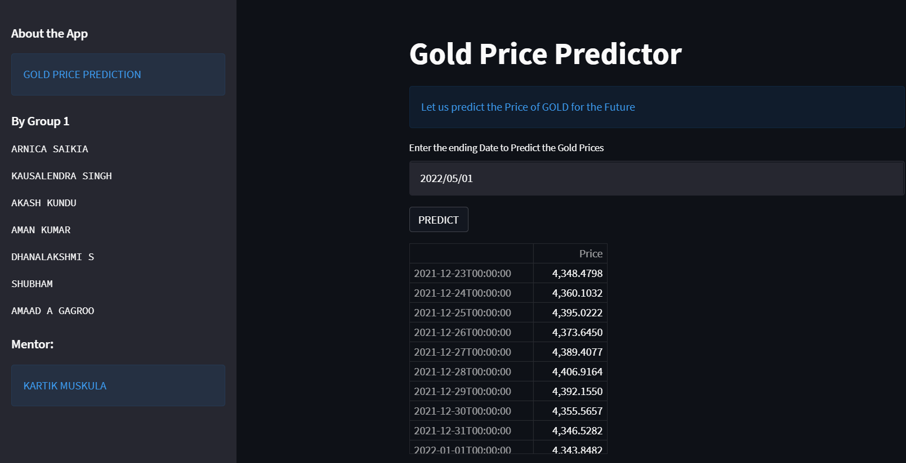
DEPLOYMENT WITH STREAMLIT – FOR NEXT 30 DAYS

Slide 26
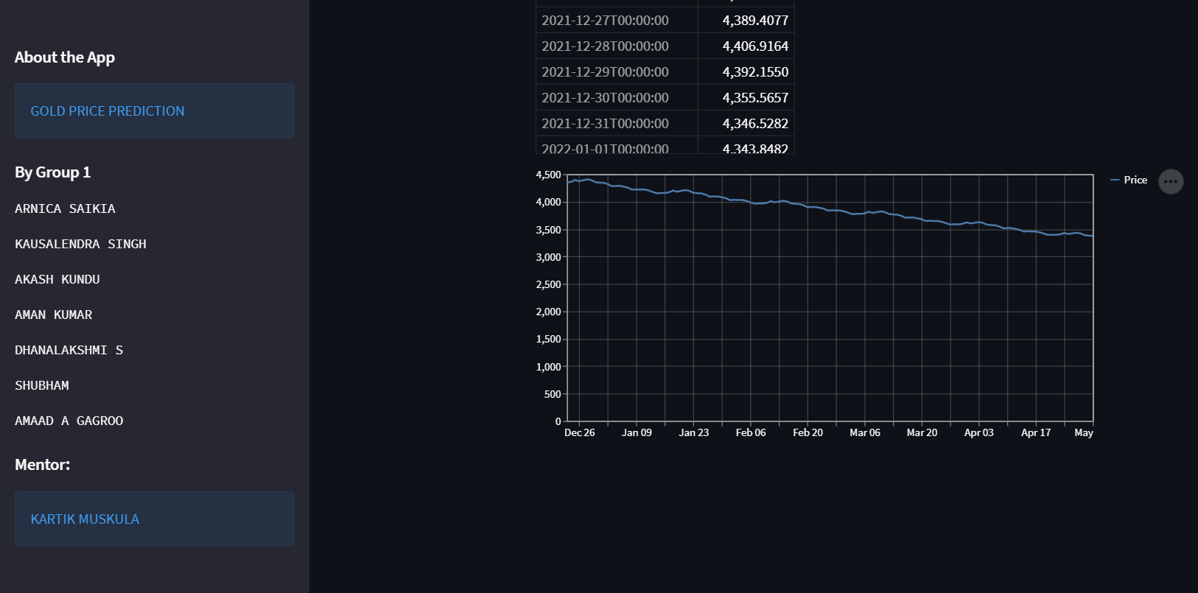
DEPLOYMENT WITH STREAMLIT – FOR NEXT 30 DAYS WITH GRAPH

Slide 27
THANK YOU

